Slide 1
BOSCH RESEARCH
Goal : combine multiple perspective view to Panorama
Louison Lu

Slide 2
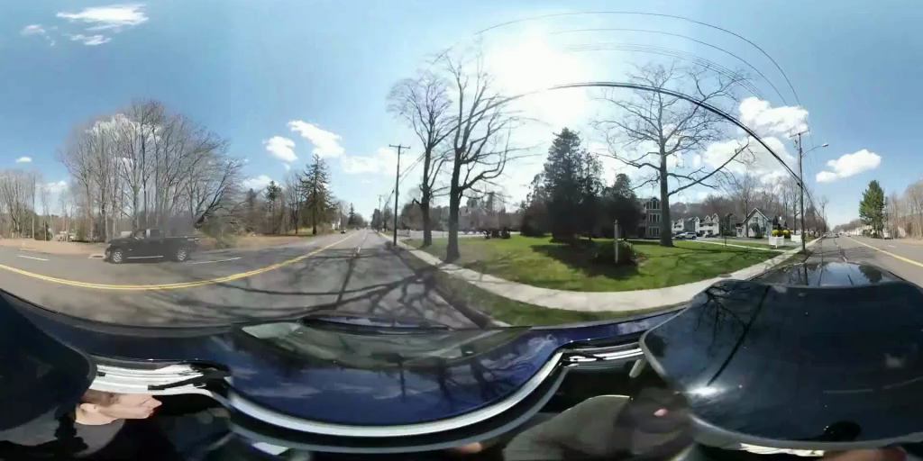
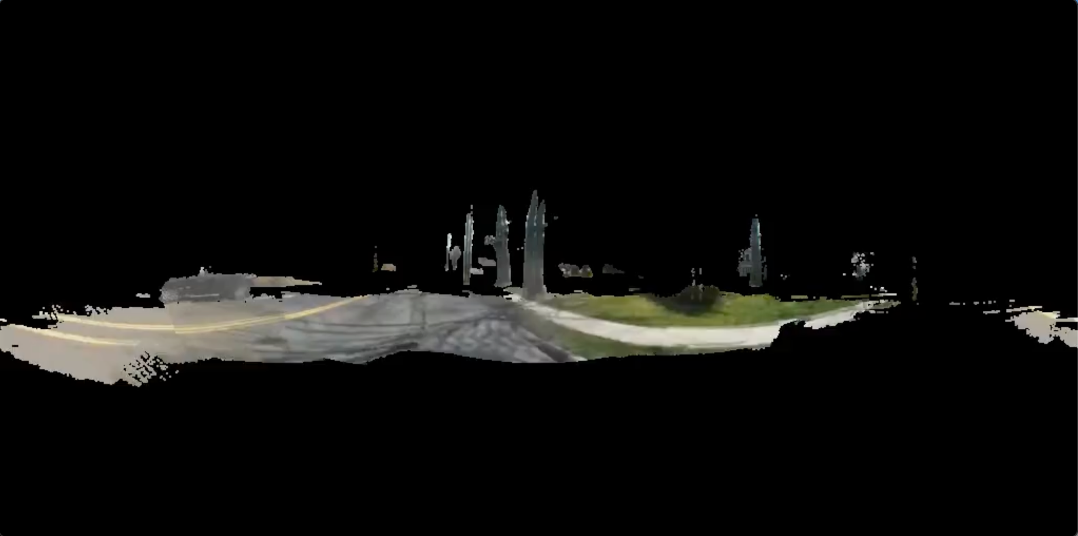
Training Dataset
RGB Video(GT)
2. Point cloud Video(pi3)
A 360-degree driving video from a moving car traveling along a sunny suburban road with houses, trees, passing cars in the opposite lane, and utility pole.
3. Prompt(.json)

Slide 3
Original Training Method(Hard lock)
X
Y
First frame . .
.
.
.
. .
.
.
.
93 frame
Lock to almost same first frame as Y (must be panorama)
RGB 360 Video (GT)
2~93 frame (PCD)
2~93 frame (GT)

Slide 4
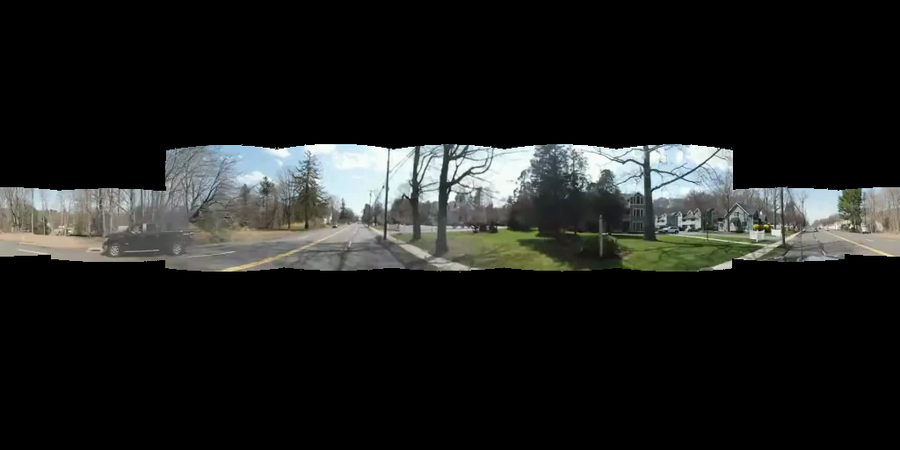
New Training Method( first frame non panorama )
X
Y
Mask 75%
RGB 360 Video (GT)
First frame . .
.
.
.
. .
.
.
.
93 frame
2~93 frame (PCD)
2~93 frame (GT)

Slide 5
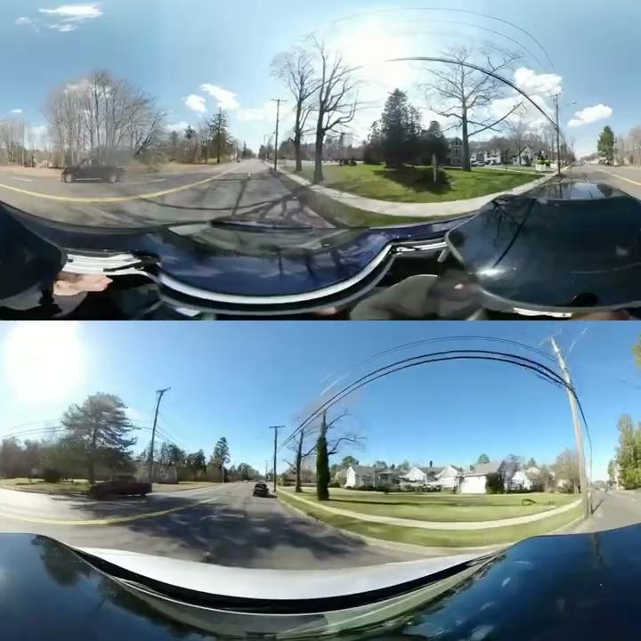
After 2000 iterations
Original(GT)
Generate

Slide 6
Compute Resource
 | Hard lock first frame(panorama) | First frame non-panorama
One iteration time | ~27 second | ~50 second
Total iteration | 2000 | 2000
Total training time | 29 hr | 40 hr
GPU | 8 x A100 80GB | 8x A100 80GB

Slide 7
Compute Resource
 | Hard lock first frame(panorama) | First frame non-panorama
One iteration time | ~27 second | ~50 second
Total iteration | 2000 | 2000
Total training time | 29 hr | 40 hr
GPU | 8 x A100 80GB | 8x A100 80GB

Slide 8
Next Step ()

